Slide 1
Chapter 6
Introduction to Trees
Objectives
Upon completion you will be able to:
Understand and use basic tree terminology and concepts
Recognize and define the basic attributes of a binary tree
Process trees using depth-first and breadth-first traversals
Parse expressions using a binary tree
Design and implement Huffman trees
Understand the basic use and processing of general trees
Data Structures: A Pseudocode Approach with C

Slide 2
6-1 Basic Tree Concepts
We begin the Chapter with a discussion of the terminology used with trees. Once the terminology is understood, we discuss three user-oriented tree representations: general trees, indented parts lists, and parenthetical trees.
Terminology
User Representation
Data Structures: A Pseudocode Approach with C

Slide 3
Basic tree concepts
A tree consists of
  a finite set of elements, called nodes, and
  a finite set of directed lines, called branches, that connect the nodes.
Data Structures: A Pseudocode Approach with C

Slide 4
Node Degree
Degree of a node
  The number of branches associated with a node.
    Indegree
      The branch is directed toward the node.
    Outdegree
      The branch is directed away from the node.
  Degree = indegree + outdegree
Data Structures: A Pseudocode Approach with C

Slide 5
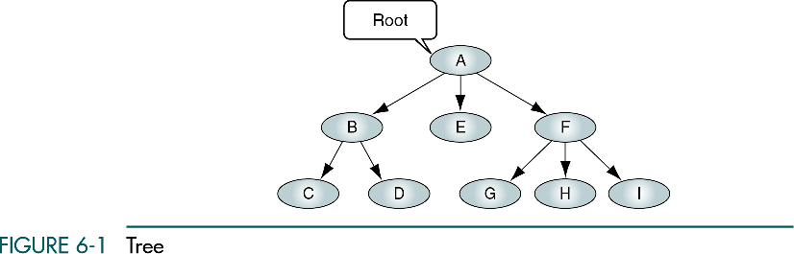
Indegree = 0
Outdegree ≥ 0
Data Structures: A Pseudocode Approach with C

Slide 6
Terminology
Leaf
  Any node with an outdegree of zero.
Internal node
  A node that is not a root or a leaf.
  Outdegree > 0
  Indegree > 0
Data Structures: A Pseudocode Approach with C

Slide 7
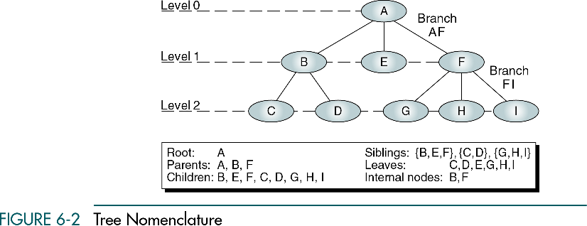
Data Structures: A Pseudocode Approach with C

Slide 8
Level and Height
Level
  The level of a node is its distance from the root.
Height (Depth)
  The height of a tree is the level of the leaf in the longest path from the root plus 1.
Data Structures: A Pseudocode Approach with C

Slide 9
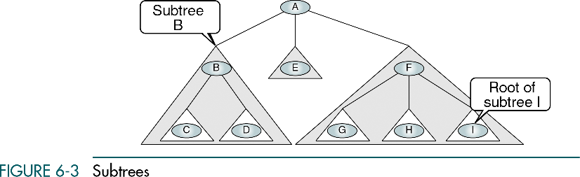
Subtree
A tree may be divided into subtrees.
A subtree is any connected structure and is used to name the subtree.
Data Structures: A Pseudocode Approach with C

Slide 10
Tree
A tree is a set of nodes that either:
  Is empty, or
  Has a designated node, called the root, from which hierarchically descend zero or more subtrees, which are also trees.
Data Structures: A Pseudocode Approach with C

Slide 11
User representation
General tree
Indented list
Parenthetical listing
Data Structures: A Pseudocode Approach with C

Slide 12
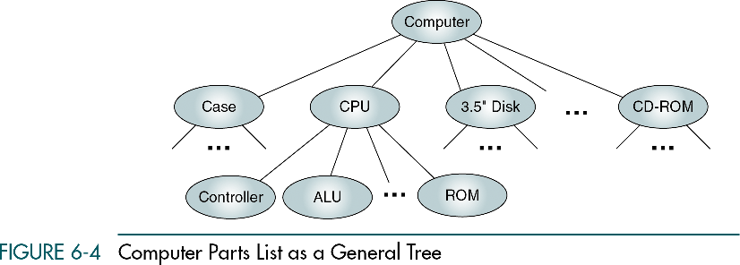
General tree
Data Structures: A Pseudocode Approach with C

Slide 13
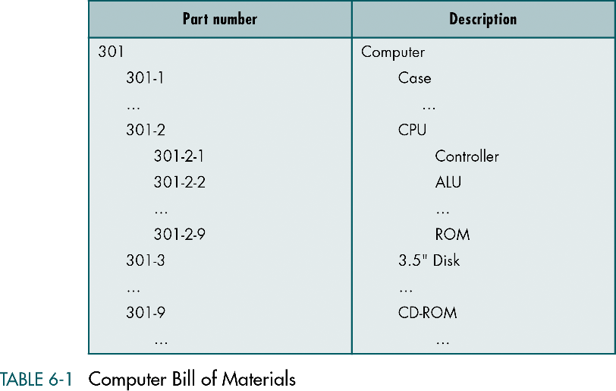
Indented list
Data Structures: A Pseudocode Approach with C

Slide 14
Parenthetical listing
A (B (C D) E F (G H I))
A
B E F
C D G H I
Data Structures: A Pseudocode Approach with C

Slide 15
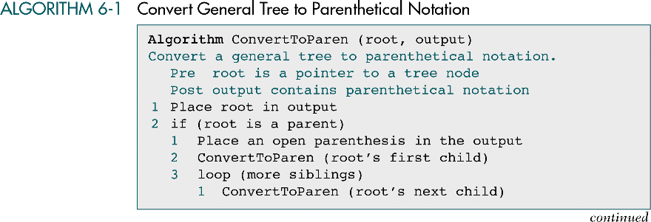
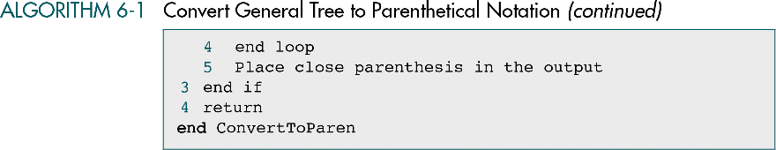
Data Structures: A Pseudocode Approach with C

Slide 16
6-2 Binary Trees
A binary tree can have no more than two descendents. In this section we discuss the properties of binary trees, four different binary tree traversals, and two applications, expression trees and Huffman Code.
Properties
Binary Tree Traversals
Expression Trees
Huffman Code
Data Structures: A Pseudocode Approach with C

Slide 17
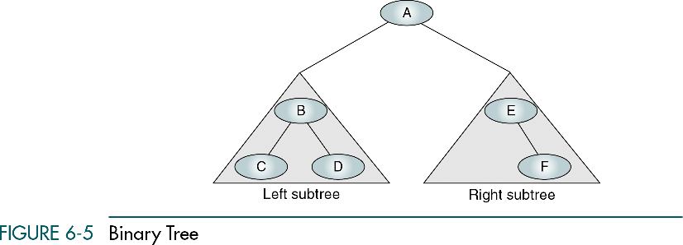
Binary trees
A binary tree is a tree in which no node have more than two subtrees.
Data Structures: A Pseudocode Approach with C

Slide 18
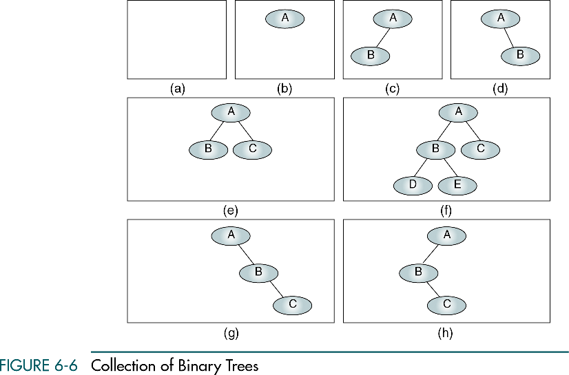
Data Structures: A Pseudocode Approach with C

Slide 19
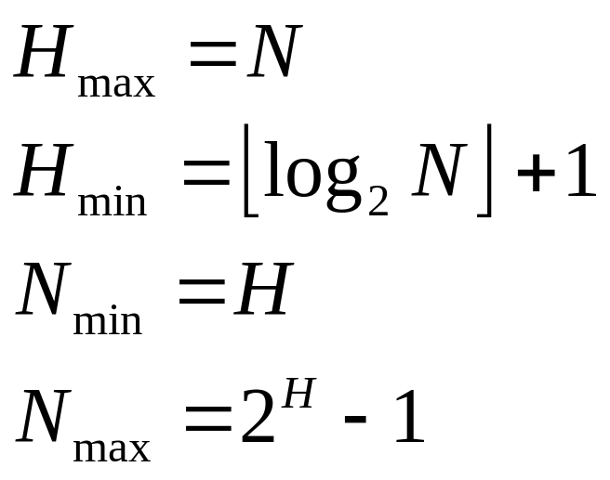
Height of binary trees
Maximum height : Minimum height : Minimum nodes : Maximum nodes :
N is the number of nodes in a binary tree. H is the height of the binary tree.
Data Structures: A Pseudocode Approach with C

Slide 20
Balance
Why balance?
  The shorter the tree, the easier it is to locate any desired node in the tree.
Data Structures: A Pseudocode Approach with C

Slide 21
Balance factor
B = HL – HR
  HL is the height of the left subtree
  HR is the height of the right subtree.
Data Structures: A Pseudocode Approach with C

Slide 22
B = H_{L} – H_{R}
B = 0
B = 1
B = -1
B = 0
B = 1
B = -2
B = 2
Data Structures: A Pseudocode Approach with C

Slide 23
Complete binary trees
A complete tree has the maximum number of entries for its height.
The maximum number is reached when the last level is full.
Data Structures: A Pseudocode Approach with C

Slide 24
Nearly complete binary trees
A tree has the minimum height for its node and
all nodes in the last level are found on the left.
Data Structures: A Pseudocode Approach with C

Slide 25
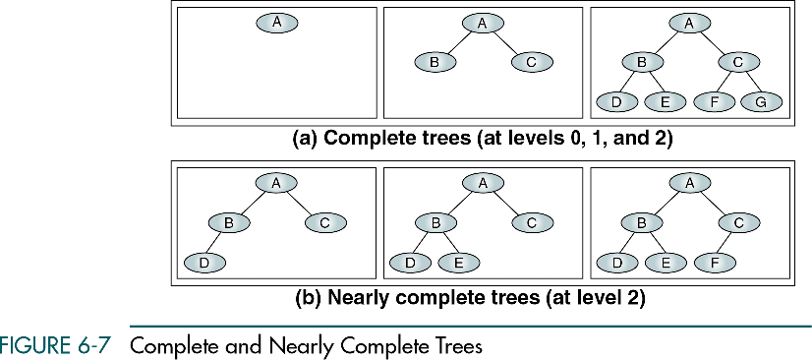
Data Structures: A Pseudocode Approach with C

Slide 26
Binary tree creation : For the new element to be added,
compare it with the current element in the tree. If its value is
less than the current element in the tree then move towards
the left side of that element or else to its right. If there is no
sub tree on the left, make your new element as the left child
of that current element or else compare it with the existing
left child and follow the same rule. Exactly same has to done
for the case when your new element is greater than the
current element in the tree but this time with the right child.
Data Structures: A Pseudocode Approach with C

Slide 27
Algorithm create_tree( struct NODE *curr, struct
NODE *new )
{
1) Create the node structure of the tree
struct NODE
{
struct NODE *left;
int value;
struct NODE *right;
}
2) if(new->value <= curr->value)
{
if(curr->left != NULL)
{
create_tree(curr->left, new);
else
curr->left = new;
Data Structures: A Pseudocode Approach with C

Slide 28
}
else
{
if(curr->right != NULL)
create_tree(curr->right, new);
else
curr->right = new;
}
}
Data Structures: A Pseudocode Approach with C

Slide 29
Binary tree traversals
A binary tree traversal requires that each node of the tree be processed once and only once in a predetermined sequence.
Two approaches
  Depth first
  Breadth first
Data Structures: A Pseudocode Approach with C

Slide 30
Binary tree traversals
Depth first
  We process all of the descendents of a child before going on the next child.
Breadth first
  Each level is completely processed before the next level is started.
Data Structures: A Pseudocode Approach with C

Slide 31
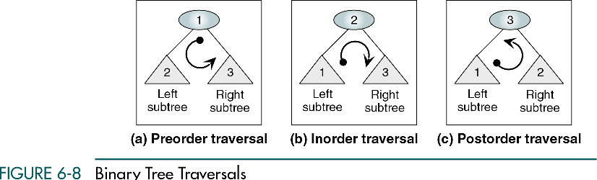
Depth-first traversals
Data Structures: A Pseudocode Approach with C

Slide 32
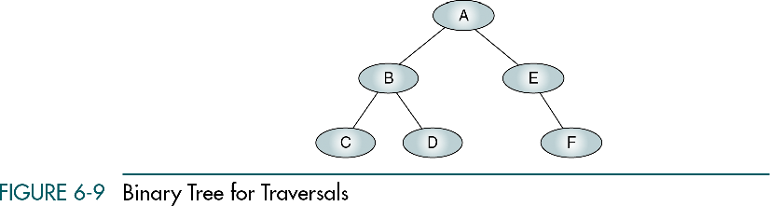
Binary tree for traversals
N (node)
L (left)
R (right)
Data Structures: A Pseudocode Approach with C

Slide 33
Preorder traversal (NLR)
In the preorder traversal, the root is processed first, before its subtrees.
The root goes before its subtrees.
1. N (node)
2. L (left)
3. R (right)
Data Structures: A Pseudocode Approach with C

Slide 34
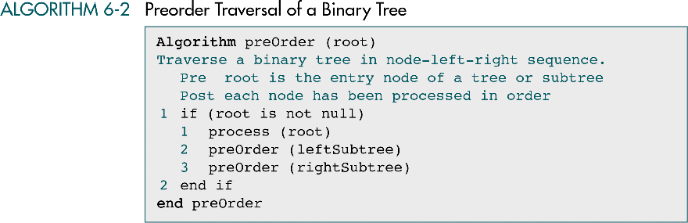
Preorder traversal (NLR)
recursive
Data Structures: A Pseudocode Approach with C

Slide 35
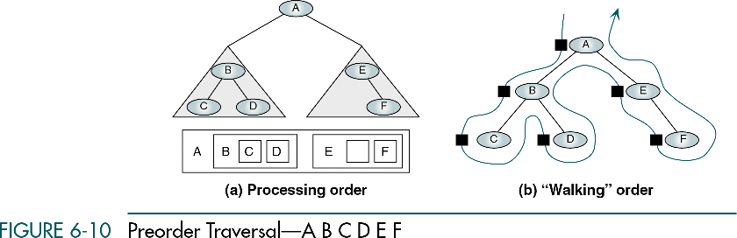
Data Structures: A Pseudocode Approach with C

Slide 36
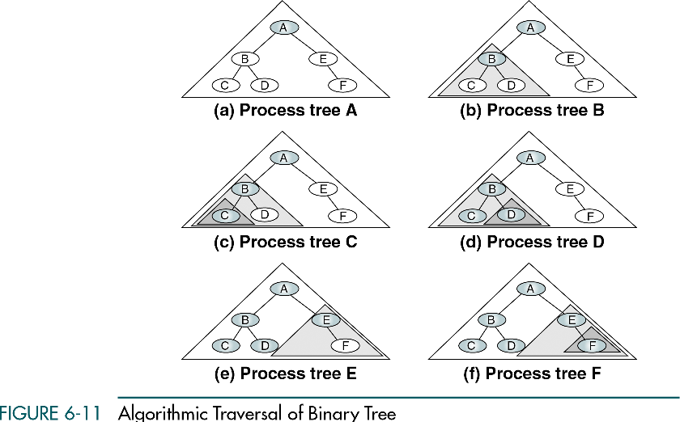
Data Structures: A Pseudocode Approach with C

Slide 37
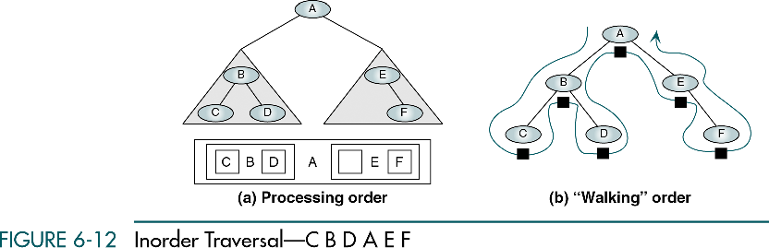
Inorder traversal
In the inorder traversal, the root is processed between its subtrees.
Data Structures: A Pseudocode Approach with C

Slide 38
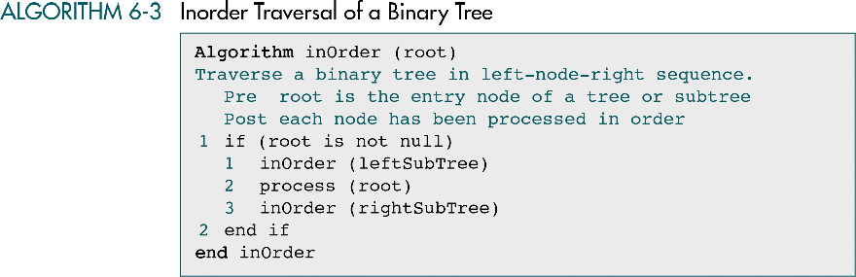
Data Structures: A Pseudocode Approach with C

Slide 39
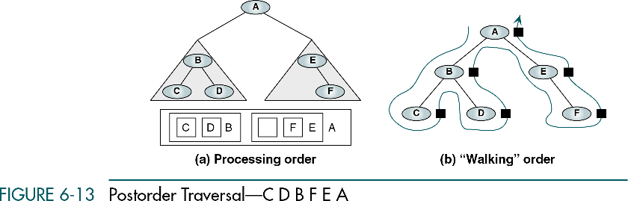
Postorder traversal (LRN)
In the postorder, the root is processed after its subtrees.
Data Structures: A Pseudocode Approach with C

Slide 40
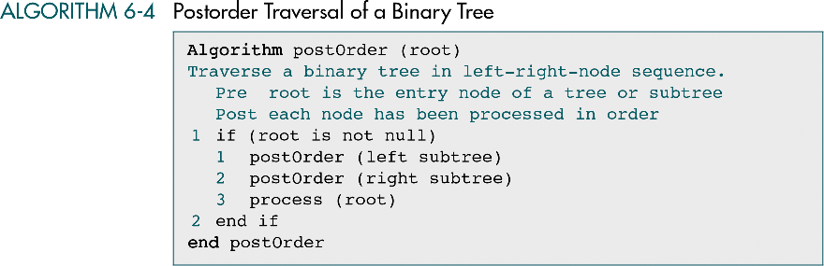
Data Structures: A Pseudocode Approach with C

Slide 41
Breadth-first traversal
We process all of the children of a node before proceeding with the next level.
Given a root at a level n, we process all nodes at level n before proceeding with the nodes at level n + 1.
Data Structures: A Pseudocode Approach with C

Slide 42
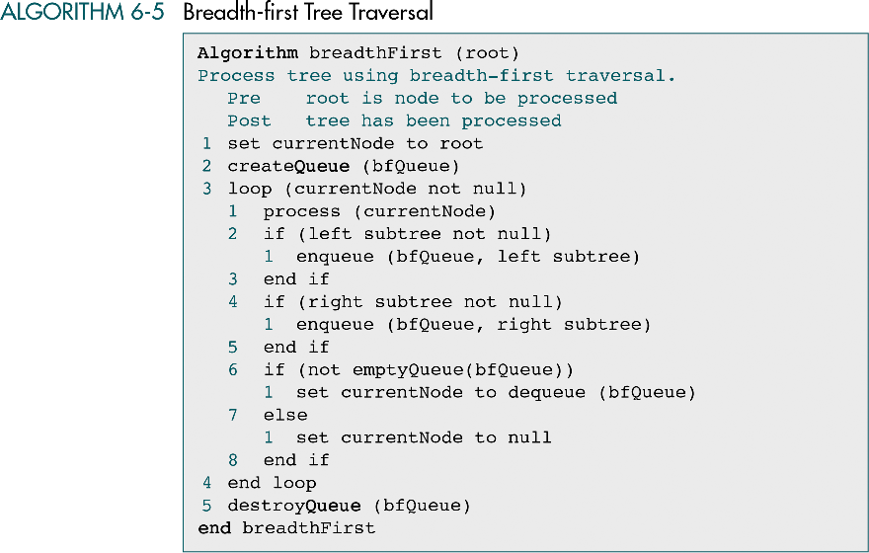
Data Structures: A Pseudocode Approach with C

Slide 43
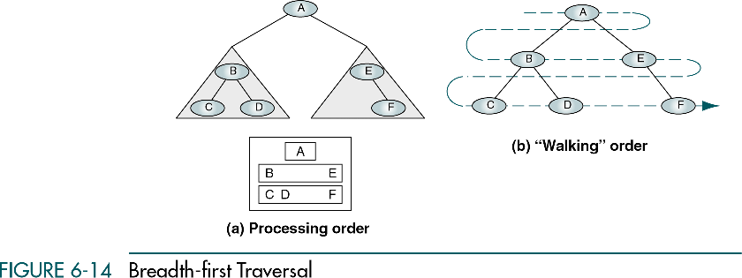
Data Structures: A Pseudocode Approach with C

Slide 44
Expression
An expression is a sequence of tokens that follow prescribed rules.
A token may be either an operand or an operator.
Data Structures: A Pseudocode Approach with C

Slide 45
Expression trees
An expression tree is a binary tree with the following properties:
  Each leaf is an operand.
  The root and internal nodes are operators.
  Subtrees are subexpressions, with the root being an operator.
Data Structures: A Pseudocode Approach with C

Slide 46
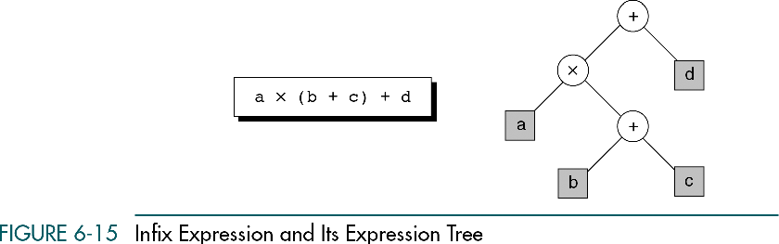
Data Structures: A Pseudocode Approach with C

Slide 47
Expression trees traversals
Infix traversal
Postfix traversal
Prefix traversal
Data Structures: A Pseudocode Approach with C

Slide 48
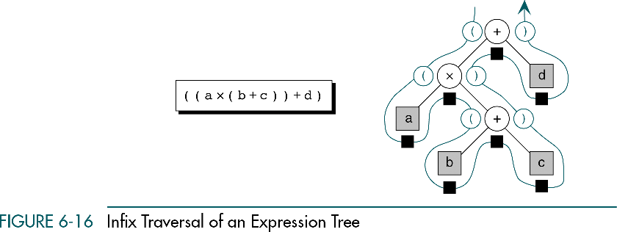
Data Structures: A Pseudocode Approach with C

Slide 49
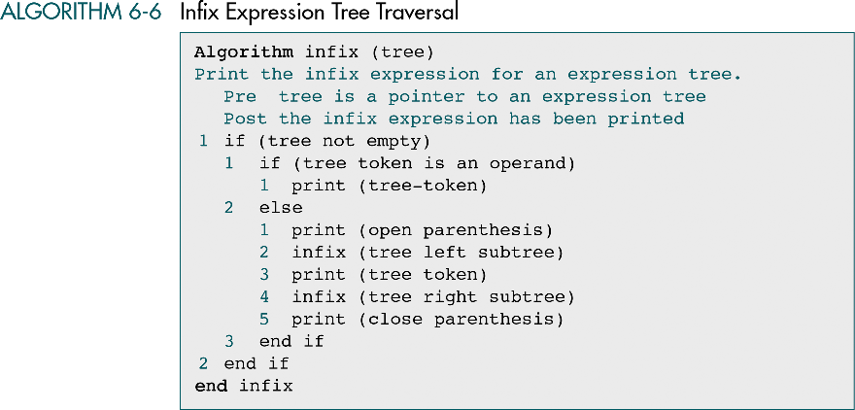
Data Structures: A Pseudocode Approach with C

Slide 50
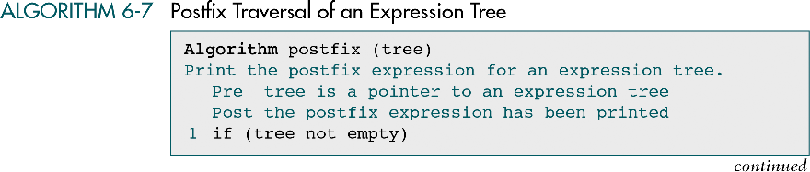
Data Structures: A Pseudocode Approach with C

Slide 51

Data Structures: A Pseudocode Approach with C

Slide 52
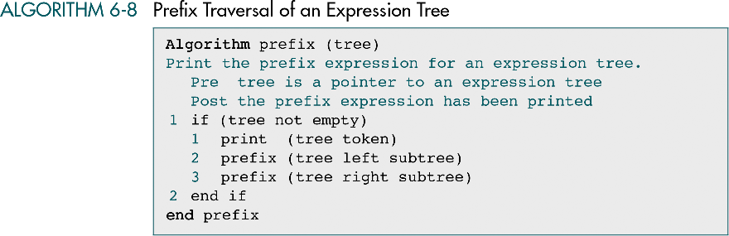
Data Structures: A Pseudocode Approach with C

Slide 53
Huffman Code
Huffman code is widely used for data compression; it reduces the number of bits sent or stored.
Data Structures: A Pseudocode Approach with C

Slide 54
Huffman Code
We used a binary tree to compress data.
  Data compression is used in many situations. E.g. sending data over internet.
Character Code:
  Each character in a normal uncompressed text file is represented in the computer by one byte or by two bytes. E.g. ASCII code
Data Structures: A Pseudocode Approach with C

Slide 55
Huffman Code
For text, the most common approach is to reduce the number of bits that represent the most-used characters.
  E.g. E is the most common letter, so few bits can be used to encode it.
Data Structures: A Pseudocode Approach with C

Slide 56
Huffman Code
No code can be the prefix of any other code.
No space characters in binary message, only 0s and 1s.
AGOODMARKET
0001101001011111000000101011011100111
Data Structures: A Pseudocode Approach with C

Slide 57
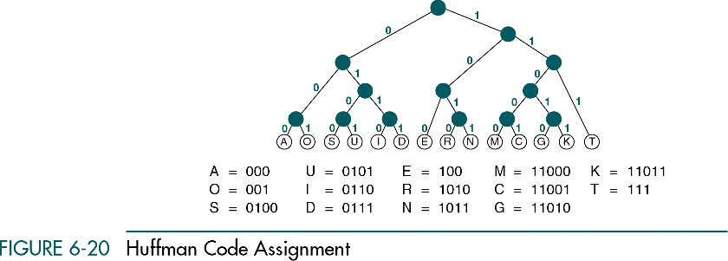
Character weights and assignments for a sample of Huffman code
Character | Weight | Character | Weight | Character | Weight
A | 10 | I | 4 | R | 7
C | 3 | K | 2 | S | 5
D | 4 | M | 3 | T | 12
E | 15 | N | 6 | U | 5
G | 2 | O | 8
Data Structures: A Pseudocode Approach with C

Slide 58
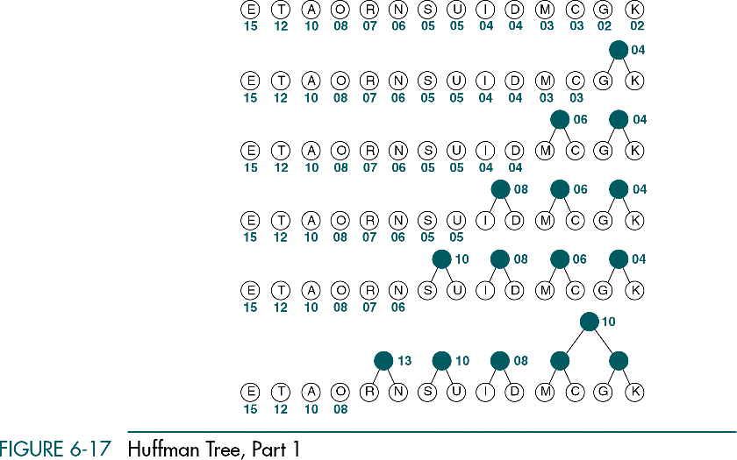
Data Structures: A Pseudocode Approach with C

Slide 59
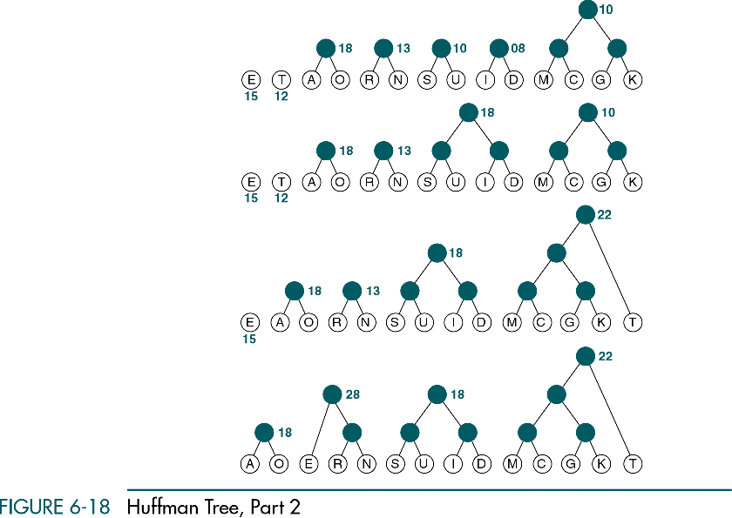
Data Structures: A Pseudocode Approach with C

Slide 60
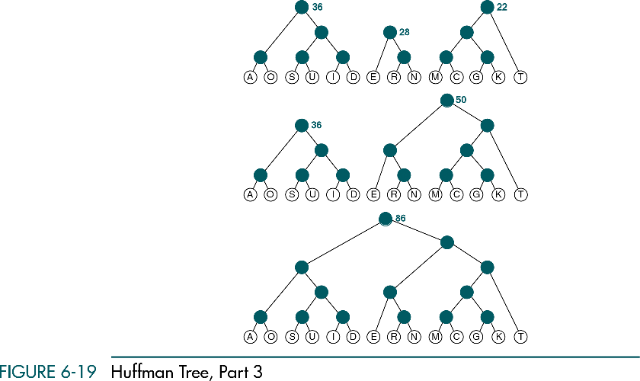
Data Structures: A Pseudocode Approach with C

Slide 61
Data Structures: A Pseudocode Approach with C

Slide 62
6-3 General Trees
A general tree can have an unlimited number of descendents. We discuss three topics in this section: general tree insertions, deletions, and converting a general tree to a binary tree.
Insertions into General Trees
General Tree Deletions
Changing a General Tree to a Binary Tree
Data Structures: A Pseudocode Approach with C

Slide 63
General Trees
A tree in which each node can have an unlimited out degree.
Data Structures: A Pseudocode Approach with C

Slide 64
Insertions into general trees
First in-first out (FIFO) insertion
Last in-first out (LIFO) insertion
Key-sequenced insertion
Data Structures: A Pseudocode Approach with C

Slide 65
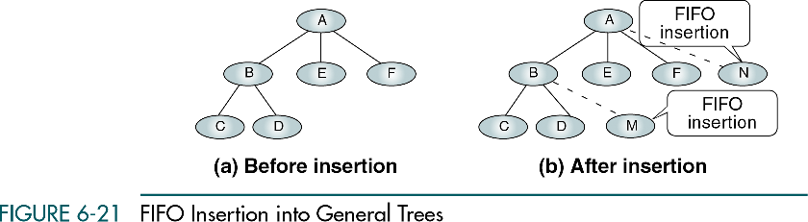
Data Structures: A Pseudocode Approach with C

Slide 66
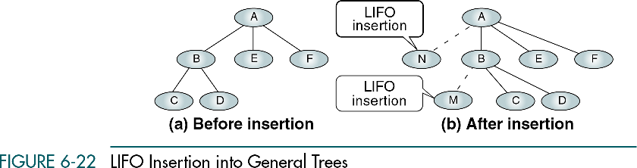
Data Structures: A Pseudocode Approach with C

Slide 67
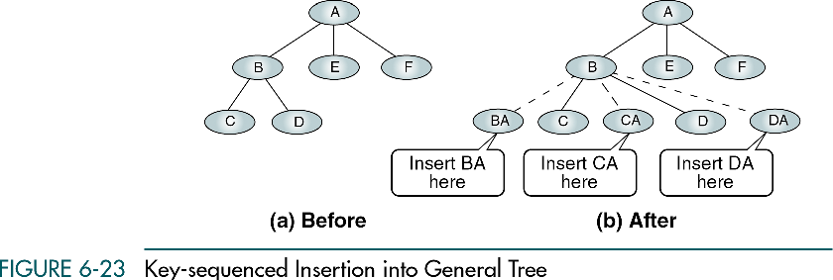
Data Structures: A Pseudocode Approach with C

Slide 68
General tree deletions
A node may be deleted only if it is a leaf.
Data Structures: A Pseudocode Approach with C

Slide 69
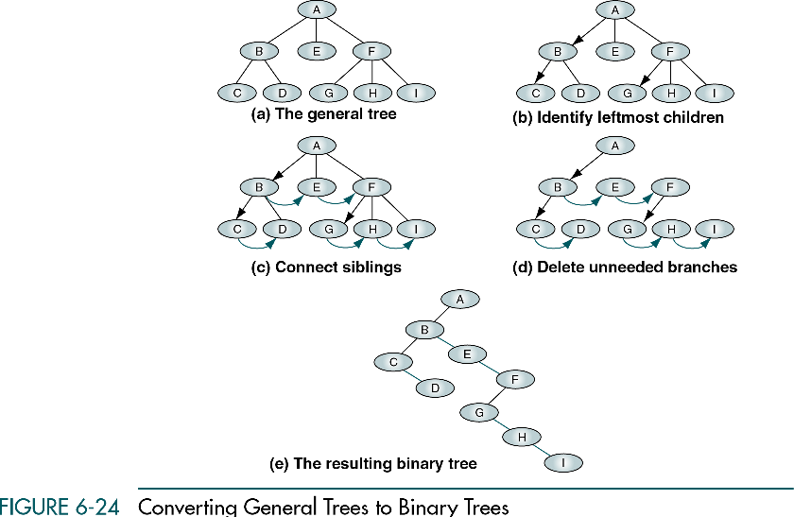
Data Structures: A Pseudocode Approach with C

